Slide 1
A library for UI/UX testing on Android based smartphones
(Final Year Project 1)
Supervisor Sir Tehseen Khan Cordinator Dr. Muhammad Nauman Group Members Junaid Ahmad (p12-6095) Muhammad Awais Afzal (p12-6029) Syed Nauyan Rashid (p12-6345)

Slide 2
Problem Description
The idea is, for UI/UX testing, it's important to know what parts of the screen the user usually interacts with.
There are heat maps in the browser/desktop world but on smartphones, there are no "mouse pointers" to track.
The user only interacts with the screen by touch events and by glancing at the screen.

Slide 3
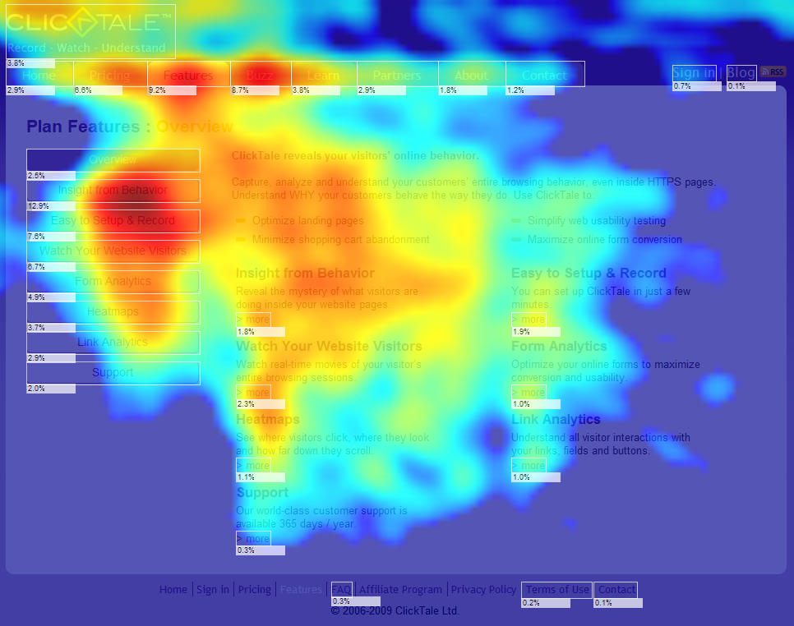
Heat maps

Slide 4
Solution
We are going to make a library for Android based smartphones.
The library will serve as a tool for UI/UX testing.
The purpose of the project is to automate the UI/UX testing criteria.
And this library would be tested by a sample Android application.

Slide 5
Description
The proposed project will aim to "track the gaze" of the user -- i.e. where are they looking at/on the screen -- to decide which part of the screen content interests them the most.
For gaze tracking, we will use OpenCV's port to Android. We will also give a sample android application for testing our library.

Slide 6
End Product
The end product will be a library that can be included in any app to serve the same purpose as heat maps on desktops . This will be for Android native applications.

Slide 7
Scope

Slide 8
Project objectives and goals:
Automate the UI/UX testing phenomena.
Target domain is Android.
End product will be a library.
Library can be included in any android application for testing.
An application for testing our library.

Slide 9
Tasks to be accomplished till the end of FYP1:
Gaze tracking.
Study of different algorithms for gaze tracking.
Algorithm selection.
Implementation of selected algorithms.
Testing of algorithms.
Application Interface.

Slide 10
Deliverable at the end of FYP1:
Complete working code of gaze tracking.
Sample Application.

Slide 11
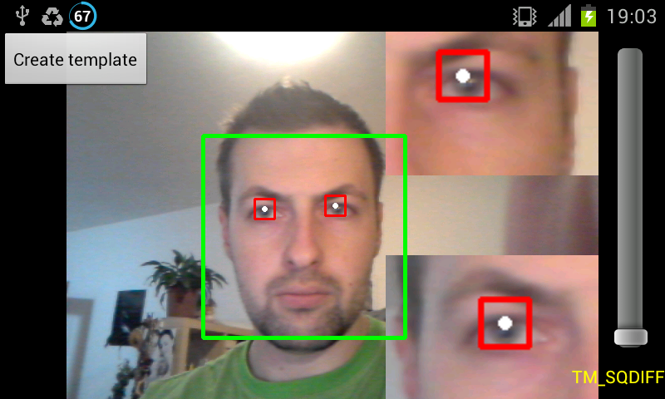
Gaze Tracking:

Slide 12
Tools
Eclipse
Android Studio
OpenCV’s port to Android

Slide 13
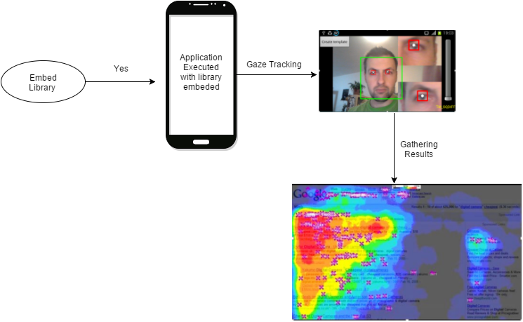
System Model Diagram

Slide 14
SWOT Analysis
Strengths :
This will help users to enhance UI/UX for testing purposes as there are heat maps in the browser/desktop world but on smartphones.
We are not using any external device for gaze tracking only web camera would be used for this purpose.
Real-Time Performance Feedback.
Low-Cost Environments That Can be Duplicated and Distributed.

Slide 15
SWOT Analysis Continue..
Weaknesses :
We will only track the gaze of the user rather than the attention.
For the time being we will only be working for Android platform.

Slide 16
SWOT Analysis Continue..
Opportunities:
Emerging Tech 1: Processing Graphics/Video Integration.
Emerging Tech 2: Real-Time Data Analysis and Intelligence.
Academic and Professional Acceptance.
Commercial Viability.

Slide 17
SWOT Analysis Continue..
Threats:
Stability of the algorithm used for gaze tracking.
Due to dynamic environment constraints and constant holstering of a smartphone, the Gaze Tracking will be a challenging task.
The Interface Challenge : Interaction Methods and Platform Compatibility.

Slide 18
Questions ?

Slide 19
Thank You!

